Slide 1
STAT 234 Lecture 4
Lei Sun
Jan 16, 2018
Lei Sun

Slide 2
Population & Sample
The Sample Mean
3
Axioms of Probability
4 Set Theory Primer
Lei Sun

Slide 3
Population & Sample
Population & Sample
Lei Sun

Slide 4
Review
Population & Sample
A population is a set of cases (observational units) about which information is wanted.
A sample is a subset of the population that is actually observed. Examples:
We want to know demographic information of Americans so we randomly select a group of 200 Americans and ask them a bunch of questions. (sample? population?)
We are interested in the tastiness of KFC burgers so we buy 5 and taste them. (sample? population?)
Somtimes a population can be conceptual.
Lei Sun

Slide 5
Why Sample?
Population & Sample
It is expensive/impossible to collect information on the whole population (when this is done it is called a census).
Even when a census is performed, it is often less accurate than a well-designed sample (hard to collect information on everything, self-report bias, non-response bias, . . . ).
With a large enough sample, we can be pretty sure of the information we want on the population, making taking a census unnecessary.
Lei Sun

Slide 6
Random Sample
Population & Sample
Bias happens when some cases are more likely to be in the sample than other cases.
Example: some political pollsters mostly call landlines, which biases the sample toward older individuals.
Random Sample: A sample that gives an equal pre-assigned chance to every unit in population to enter sample.
Frees the sample from bias
So that the sample is representative of population Effectively neutralize all confounding factors at once
Lei Sun

Slide 7
Probability & Inference
Population & Sample
Probability: If we know the population (or at least a reasonable model for it), then we can determine what a random sample is “likely” to look like using probability.
Population −→ sample?
(Statistical) Inference: If we only have the sample, what can we reasonably conclude about the population?
Sample −→ population?
Lei Sun

Slide 8
Parameters & Statistics
Population & Sample
A parameter is a number that describes a population. It is usually unknown and what we want information on. People usually use greek letter µ, σ, ρ to represent parameters.
A statistic is a number that describes a sample, sometimes called summary statistic. It can be derived from the sample and is used to estimate a population parameter. People usually use latin letters x¯, s, r to represent statistics.
We want to know the average height of UChicago male students so we measured the average height of a sample of 50 UChicago male students and came up with 5’11”. (population? sample? parameter? statistic?)
Lei Sun

Slide 9
The Sample Mean
The Sample Mean
Lei Sun

Slide 10
Gettysburg Address
The Sample Mean
President Lincoln’s Gettysburg Address (November 19, 1863)
Four score and seven years ago our fathers brought forth, on this continent, a new nation, conceived in Liberty, and dedicated to the proposition that all men are created equal. . . .
286 words in total.
What is the average word length of Gettysburg Address?
Lei Sun

Slide 11
World Length
The Sample Mean
## |  | word | length
## | 1 | Four | 4
## | 2 | score | 5
## | 3 | and | 3
## | 4 | seven | 5
## | 5 | years | 5
## | 6 | ago | 3
## | 7 | our | 3
## | 8 | fathers | 7
## | 9 | brought | 7
## | 10 | forth | 5
Lei Sun

Slide 12
Average Word Length
The Sample Mean
Suppose I want to know the average word length of Gettysburg Address.
Population: All the words in the Address.
Of course, we know the actual population mean µ because we have the entire population.
mean(gettysburg$length)
## [1] 4.294776
Lei Sun

Slide 13
Word Sample
The Sample Mean
What if we only use a sample of 10 words?
## |  | word | length
## | 130 | it | 2
## | 132 | above | 5
## | 93 | is | 2
## | 237 | in | 2
## | 124 | dead | 4
## | 19 | liberty | 7
## | 10 | forth | 5
## | 31 | Now | 3
## | 121 | men | 3
## | 37 | great | 5
## sample mean = 3.8
Lei Sun

Slide 14
Point Estimate
The Sample Mean
A point estimate is a single number used to estimate a population parameter.
The sample average here is a point estimate of the population mean. How would you estimate the population median?
How would you estimate the population standard deviation?
Lei Sun

Slide 15
Samples are Random
The Sample Mean
Since the sample is drawn at random, we could have obtained a different sample, and so a different point estimate.
## |  | word | length
## | 252 | that | 4
## | 128 | have | 4
## | 214 | cause | 5
## | 216 | which | 5
## | 217 | they | 4
## | 236 | died | 4
## | 7 | our | 3
## | 248 | birth | 5
## | 47 | so | 2
## | 246 | a | 1
## sample mean = 3.7
Lei Sun

Slide 16
Another Sample
The Sample Mean
## |  | word | length
## | 202 | us | 2
## | 203 | that | 4
## | 41 | whether | 7
## | 77 | final | 5
## | 85 | their | 5
## | 65 | We | 2
## | 112 | cannot | 6
## | 23 | the | 3
## | 88 | that | 4
## | 167 | rather | 6
## sample mean = 4.4
Lei Sun

Slide 17
Another Sample
The Sample Mean
## |  | word | length
## | 29 | created | 7
## | 23 | the | 3
## | 134 | poor | 4
## | 223 | of | 2
## | 177 | they | 4
## | 113 | consecrate | 10
## | 38 | civil | 5
## | 167 | rather | 6
## | 154 | can | 3
## | 50 | so | 2
## sample mean = 4.6
Lei Sun

Slide 18
Another Sample
The Sample Mean
## |  | word | length
## | 117 | this | 4
## | 185 | nobly | 5
## | 49 | and | 3
## | 263 | shall | 5
## | 30 | equal | 5
## | 206 | honored | 7
## | 210 | increased | 9
## | 105 | a | 1
## | 35 | in | 2
## | 255 | the | 3
## sample mean = 4.4
Lei Sun

Slide 19
More Samples
The Sample Mean
## | word | length | sample: | 6 | 4 | 9 | 4 | 6 | 3 | 3 | 9 | 4 | 4 | ; | sample | mean | = | 5.
## | word | length | sample: | 4 | 4 | 2 | 2 | 4 | 5 | 3 | 4 | 5 | 5 | ; | sample | mean | = | 3.
## | word | length | sample: | 2 | 2 | 6 | 2 | 3 | 4 | 5 | 4 | 7 | 2 | ; | sample | mean | = | 3.
## | word | length | sample:
## | word | length | sample: | 5 | 9 | 4 | 4 | 6 | 9 | 3 | 4 | 4 | 3 | ; | sample | mean | = | 5.
## | word | length | sample: | 2 | 6 | 3 | 9 | 3 | 4 | 2 | 7 | 4 | 4 | ; | sample | mean | = | 4.
## | word | length | sample: | 7 | 4 | 2 | 4 | 4 | 2 | 3 | 3 | 2 | 6 | ; | sample | mean | = | 3.
## | word | length | sample: | 6 | 5 | 2 | 2 | 2 | 5 | 4 | 2 | 4 | 4 | ; | sample | mean | = | 3.
## | word | length | sample: | 4 | 4 | 6 | 1 | 4 | 4 | 4 | 4 | 6 | 6 | ; | sample | mean | = | 4.
## | word | length | sample: | 3 | 3 | 5 | 2 | 4 | 4 | 4 | 2 | 7 | 7 | ; | sample | mean | = | 4.
10 3 8 2 4 2 5 5 3 9 ; sample mean = 5
Lei Sun

Slide 20
Sampling Distribution
The Sample Mean
With every random sample we are getting a different x¯. The sample average is thus also random.
We can ask what possible values x¯ can take and how often it takes those values.
That is, we can ask about x¯’s distribution, called x¯’s sampling distribution.
A sampling distribution is the distribution of a sample statistic.
Lei Sun

Slide 21
Sampling Distribution
The Sample Mean
We can repeat sampling 1000 times, and plot the sampling distribution.
50 100 150 200 250
Population mean
of word length in Gettysburg Address
Frequency
0
3
4 5
x: Sample mean of word length
6
Lei Sun

Slide 22
Sampling Distribution
The Sample Mean
The sampling distribution of the sample mean has the population mean
sort of at the center.
But there is a lot of variablity in sample means.
A sample of 10 words could contain a few big words by chance, which gives a bigger sample mean, and vice versa.
The standard deviation of the sampling distribution associated with a point estimate is called a standard error.
sd(word.sample.mean)
## [1] 0.6389422
Lei Sun

Slide 23
Sample Size
The Sample Mean
The standard error of the sample average is related to the sample size
n.
## sample size = 10 ; standard error = 0.6607
## sample size = 20 ; standard error = 0.4555
## sample size = 40 ; standard error = 0.3105
## sample size = 80 ; standard error = 0.1987
Lei Sun

Slide 24
Standard Error
The Sample Mean
Standard error of sample size n: Given n independent observations from a population with standard deviation σ, the standard error of the sample mean is equal to
SE = ^{σ}
√_{n}
Since σ is generally unknown, we estimate SE with ^{s} , where s is the
√_{n}
sample standard deviation.
Lei Sun

Slide 25
Sample Size
The Sample Mean
Standard error decreases as sample size increases!
Population Mean
Distribution of Sample Mean
6
5
4
3
10
20
40
80
Sample Size
Lei Sun

Slide 26
Sampling Distribution & Sample Size
The Sample Mean
0.5
0.8
0.4
0.4 0.6
Density
0.3
Density
0.2
0.1
0.2
0.0
0.0
3
4
5
6
7
3.5
4.0
4.5 5.0
x of sample size 20
5.5
6.0
x of sample size 10
0.0 0.2 0.4 0.6 0.8 1.0 1.2
0.0 0.5 1.0 1.5
Density
Density
3.5
4.0 4.5
x of sample size 40
5.0
3.6
3.8
4.0
4.2 4.4
x of sample size 80
4.6
4.8
5.0
Lei Sun

Slide 27
Sampling Distribution & Sample Size
The Sample Mean
0.5
0.8
0.4
0.4 0.6
Density
0.3
Density
0.2
0.1
0.2
0.0
0.0
3
4 5
x of sample size 10
6
3
4 5
x of sample size 20
6
0.0 0.2 0.4 0.6 0.8 1.0 1.2
0.0 0.5 1.0 1.5
Density
Density
3
4 5
x of sample size 40
6
3
4 5
x of sample size 80
6
Lei Sun

Slide 28
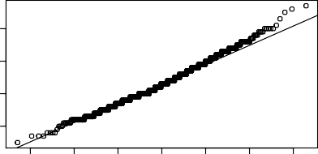
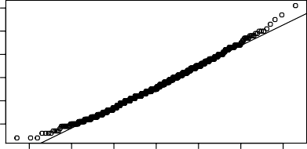
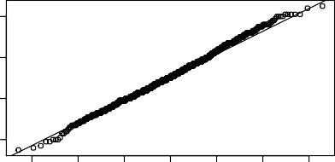
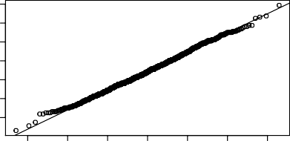
Sampling Distribution & Sample Size
The Sample Mean
Normal Q−Q Plot: 10
Normal Q−Q Plot: 20
6.0
Sample Quantiles
6
Sample Quantiles
4.0 4.5 5.0 5.5
5
4
3
3.5
−3
−2
−1 0 1
Theoretical Quantiles
2
3
−3
−2
−1 0 1
Theoretical Quantiles
2
3
Normal Q−Q Plot: 40
Normal Q−Q Plot: 80
5.0
5.0
Sample Quantiles
4.5
Sample Quantiles
4.6
4.0
4.2
3.5
3.8
−3
−2
−1 0 1
Theoretical Quantiles
2
3
−3
−2
−1 0 1
Theoretical Quantiles
2
3
Lei Sun

Slide 29
Convergence to Normality
The Sample Mean
In general, the sampling distribution of sample means converges to a normal distribution as the sample size increases.
Many other statistics do this as well (proportions, medians, standard deviations).
It’s called the “central limit theorem”.
Lei Sun

Slide 30
Skewed Distribution
The Sample Mean
For highly skewed distributions, it takes more samples for normality to be a good approximation.
Histogram of email$num_char
1000 2000 3000
Frequency
0
0
50
100
150
200
Number of Characters in Emails
## population mean = 10.71
Lei Sun

Slide 31
Sampling Distributions
The Sample Mean
0.12
0.06
0.08
Density
0.04
Density
0.02
0.04
0.00
0.00
0
10
20
30
40
50
60
5
10
15
20
25
x of sample size 4
x of sample size 20
0.30
0.0 0.1 0.2 0.3 0.4 0.5 0.6
0.20
Density
Density
0.10
0.00
6
8
10 12
x of sample size 100
14
16
9
10 11
x of sample size 500
12
13
Lei Sun

Slide 32
Sampling Distributions
The Sample Mean
0.12
0.06
0.08
Density
0.04
Density
0.02
0.04
0.00
0.00
0
10
20 30
x of sample size 4
40
50
0
10
20 30
x of sample size 20
40
50
0.30
0.0 0.1 0.2 0.3 0.4 0.5 0.6
0.20
Density
Density
0.10
0.00
0
10
20 30
x of sample size 100
40
50
0
10
20 30
x of sample size 500
40
50
Lei Sun

Slide 33
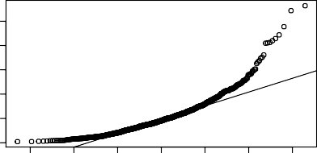
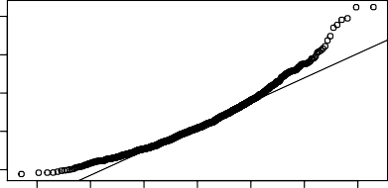
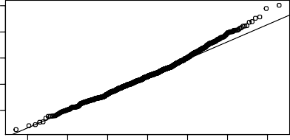
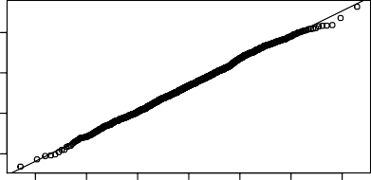
Sampling Distributions
The Sample Mean
Normal Q−Q Plot: 4
Normal Q−Q Plot: 20
50
10 15 20 25
Sample Quantiles
40
Sample Quantiles
30
20
10
0
5
−3
−2
−1 0 1
Theoretical Quantiles
2
3
−3
−2
−1 0 1
Theoretical Quantiles
2
3
Normal Q−Q Plot: 100
Normal Q−Q Plot: 500
16
14
10 11 12
Sample Quantiles
Sample Quantiles
12
8 10
9
−3
−2
−1 0 1
Theoretical Quantiles
2
3
−3
−2
−1 0 1
Theoretical Quantiles
2
3
Lei Sun

Slide 34
Other Statistics
The Sample Mean
Every statistic, when it is obtained from a random sample, has a sampling distribution.
Sampling distribution
of sample standard deviation
Sampling distribution of sample median
Sampling distribution of sample maximum
300
200
200
250
150
100 150 200
150
Frequency
Frequency
Frequency
100
100
50
50
50
0
0
0
10 12 14 16 18 20
4.5 5.0 5.5 6.0 6.5 7.0 7.5 8.0
60 80 100 120 140 160 180 200
s (n = 500)
M (n = 500)
max (n = 500)
But not all statistics’ sampling distributions converge to a normal.
Lei Sun

Slide 35
Axioms of Probability
Axioms of Probability
Lei Sun

Slide 36
Sample vs Population
Axioms of Probability
A population is a group of cases for which you want information. A sample is a subgroup of cases of the population.
A simple random sample (SRS) is when we choose a subset of the population where each subject is equally likely to be chosen.
Lei Sun

Slide 37
Probability & Statistics
Axioms of Probability
Statistics (Inference):
From a sample, what can we conclude (probabilistically) about the population?
Sample → Population?
Messy, as much an art as a science.
In reality: no correct answers, lots of ways to be wrong. Some “good enough” answers.
Probability (from the viewpoint of Statisticians):
Logically self-contained, a subset of Mathematics. One correct answer.
We know the population. What is the probability of the sample? Population → Sample?
Lei Sun

Slide 38
Probability
Axioms of Probability
We call a phenomenon random if individual outcomes are uncertain but nonetheless, there is a regular distribution of outcomes in a large number of repetitions.
The probability of any outcome of a random phenomenon is the proportion of times the outcome would occur in a very long series of repetitions.
The basic prototype to think about probability: flipping a coin.
The probability of a fair coin landing heads is 0.5 because, in the long run, half of the time the coin will land heads.
Lei Sun

Slide 39
1 Flip
Axioms of Probability
1.0
0.8
Proportion Heads
0.6
0.4
0.2
0.0
0
10
20
30
40
50
Times Flipped
Lei Sun

Slide 40
2 Flips
Axioms of Probability
1.0
0.8
Proportion Heads
0.6
0.4
0.2
0.0
0
10
20
30
40
50
Times Flipped
Lei Sun

Slide 41
3 Flips
Axioms of Probability
1.0
0.8
Proportion Heads
0.6
0.4
0.2
0.0
0
10
20
30
40
50
Times Flipped
Lei Sun

Slide 42
4 Flips
Axioms of Probability
1.0
0.8
Proportion Heads
0.6
0.4
0.2
0.0
0
10
20
30
40
50
Times Flipped
Lei Sun

Slide 43
5 Flips
Axioms of Probability
1.0
0.8
Proportion Heads
0.6
0.4
0.2
0.0
0
10
20
30
40
50
Times Flipped
Lei Sun

Slide 44
10 Flips
Axioms of Probability
1.0
0.8
Proportion Heads
0.6
0.4
0.2
0.0
0
10
20
30
40
50
Times Flipped
Lei Sun

Slide 45
50 Flips
Axioms of Probability
1.0
0.8
Proportion Heads
0.6
0.4
0.2
0.0
0
10
20
30
40
50
Times Flipped
Lei Sun

Slide 46
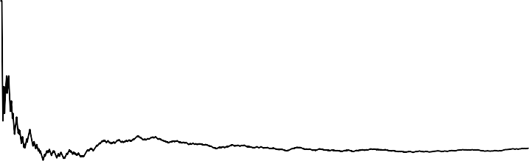
1000 Flips
Axioms of Probability
1.0
0.8
Proportion Heads
0.6
0.4
0.2
0.0
0
200
400
600
800
1000
Times Flipped
Lei Sun

Slide 47
Law of Large Numbers
Axioms of Probability
We’ve just observed the law of large numbers.
Law of Large Numbers (LLN): if a random trial is repeated, the proportion pˆ_{n} of occurrences with a particular outcome converges to the probability p of that outcome.
Lei Sun

Slide 48
Sample Spaces & Events
Axioms of Probability
The sample space S of a random phenomenon is the set of all possible outcomes.
An event is an outcome or a set of outcomes of a random phenomenon.
An event is a subset of the sample space. Example: suppose you roll a fair six-sided die once.
What is the sample space S?
What is the event
“roll a six”
“roll an even number” “roll more than 2”
What does the set {2, 3, 4} mean? How many distinct events are possible?
Usually denote the set of all possible events by A.
Lei Sun

Slide 49
Sample Space & Events
Axioms of Probability
Suppose you flip a fair coin twice and observe the sequence of heads and tails.
What is the sample space S?
What is the set of all the possible events A?
Suppose instead of the sequence, you measure the number of heads.
What is the sample space S?
What is the set of all the possible events A?
Lei Sun

Slide 50
Axioms of Probability
Axioms of Probability
A probability on a sample space S (and a set A of events) is a function which assigns each event A ∈ A a value in [0, 1] and satisfies the following rules:
Axiom 1: All probabilities are nonnegative.
∀A ∈ A, P(A) ≥ 0 .
Axiom 2: The probability of the whole sample space is 1.
P(S) = 1 .
Axiom 3 (Addition Rule): If two events A and B are disjoint (have no outcomes in common, A ∩ B = ∅) then
P(A ∪ B) = P(A) + P(B) .
Lei Sun

Slide 51
Probability
Axioms of Probability
Suppose a random experiment has N different outcomes, such that i th outcomes occurs with probability p_{i} , i = 1, . . . , N. It is natural to define the probability of an event as the sum of the probabilities of the distinct outcomes making up the event.
A special case: Symmetry of outcomes: all outcomes of an experiment are assumed equally likely.
Assume N outcomes. Probability of an outcome: 1/N.
Probability of event containing n outcomes: n/N. Requires finitely many and equally likely outcomes. Probablity can be determined by counting outcomes.
Example: Roll a six-sided die,
P(1) = P(2) = P(3) = P(4) = P(5) = P(6) = ¹ .
6
Probability of “roll an odd number”:
P({1, 3, 5}) = P(1) + P(3) + P(5) = 1/2.
Lei Sun

Slide 52
Counting
Axioms of Probability
Why do we need to learn techniques for counting? If outcomes are equally likely, p₁ = · · · = p_{n} = 1/n, then for any event A,
#(A) number of outcomes in A
P(A) =
=
#(S) number of outcomes in S
This setup satisfies the 3 axioms
P(A) ≥ 0
If A and B are disjoint then
#(S)
P(S) =
= 1
#(A ∪ B)
#(A) #(B)
#(S)
P(A ∪ B) =
= +
#(S) #(S) #(S)
= P(A) + P(B).
Lei Sun

Slide 53
Set Theory Primer
Set Theory Primer
Lei Sun

Slide 54
Sets
Set Theory Primer
A set is “a collection of definite, well distinguished objects of our perception or of our thought”. (Georg Cantor, 1845-1918)
Some important sets:
N = {1, 2, 3, . . .}, the set of natural numbers
Z = {. . . , −2, −1, 0, 1, 2, . . .}, the set of integers
R = (−∞, ∞), the set of real numbers
Intervals are denoted as follows:
[0, 1]
[0, 1)
(0, 1)
the interval from 0 to 1 including 0 and 1
the interval from 0 to 1 including 0 but not 1
the interval from 0 to 1 not including 0 and 1
If a is an element of the set A then we write a ∈ A.
If a is not an element of the set A then we write a ∈/ A.
Lei Sun

Slide 55
Venn Diagram
Set Theory Primer
Set’s are intuitively thought of in terms of Venn diagrams
S = a set, A = a subset of S, B = another subset of S. Denoted A ⊆ S and B ⊆ S.
S
A
B
Lei Sun

Slide 56
Empty Set
Set Theory Primer
The set with no element is called the empty set. Denoted ∅ or ∅.
For any set A, we have ∅ ⊆ A.
Lei Sun

Slide 57
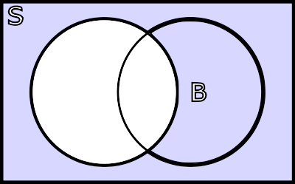
Set Complement
Set Theory Primer
The set complement of A: the set of all elements in S but not in A. Denoted A^{c} or A^{t} or A¯ .
S
A
B
Lei Sun

Slide 58
Intersection
Set Theory Primer
The intersection of A and B: the set of all elements in S which are in both A and B.
Denoted A ∩ B.
S
A
B
What is A ∩ A^{c} ?
Lei Sun
58 / 62

Slide 59
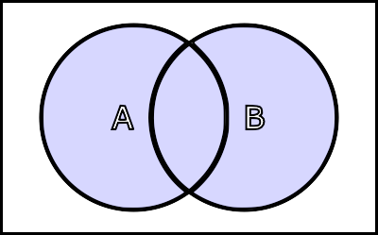
Set Union
Set Theory Primer
The union of A and B: the set of all elements in S that are in A or B
or both. Denoted A ∪ B.
S
A
B
What is A ∪ A^{c} ?
Lei Sun
59 / 62

Slide 60
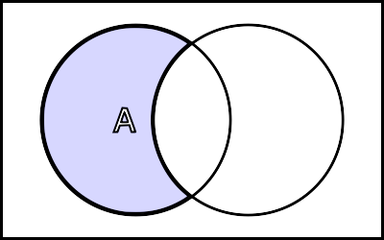
Set Difference
Set Theory Primer
The set difference of A and B: the set of all elements in A but not in
B.
Denoted A \ B.
S
A
B
A \ B = A ∩ B^{c}
Lei Sun
60 / 62

Slide 61
Disjoint
Set Theory Primer
Two sets A and B are disjoint or mutually exclusive if A and B have no common elements, or A ∩ B = ∅.
S
A
B
Lei Sun

Slide 62
Results
Set Theory Primer
A ∩ A^{c} = ∅
A ∪ A^{c} = S
(A^{c} )^{c} = A
∅^{c} = S
c
S = ∅
De Morgan’s Laws
c
(A ∩ B) = A^{c} ∪ B^{c}
c
(A ∪ B) = A^{c} ∩ B^{c}
Lei Sun

